Slide 1
ATOM Modeling Pipeline (AMPL) for Drug Discovery
S. Ravichandran Data Scientist, BIDS, FNLCR
June 8, 2021

Slide 2
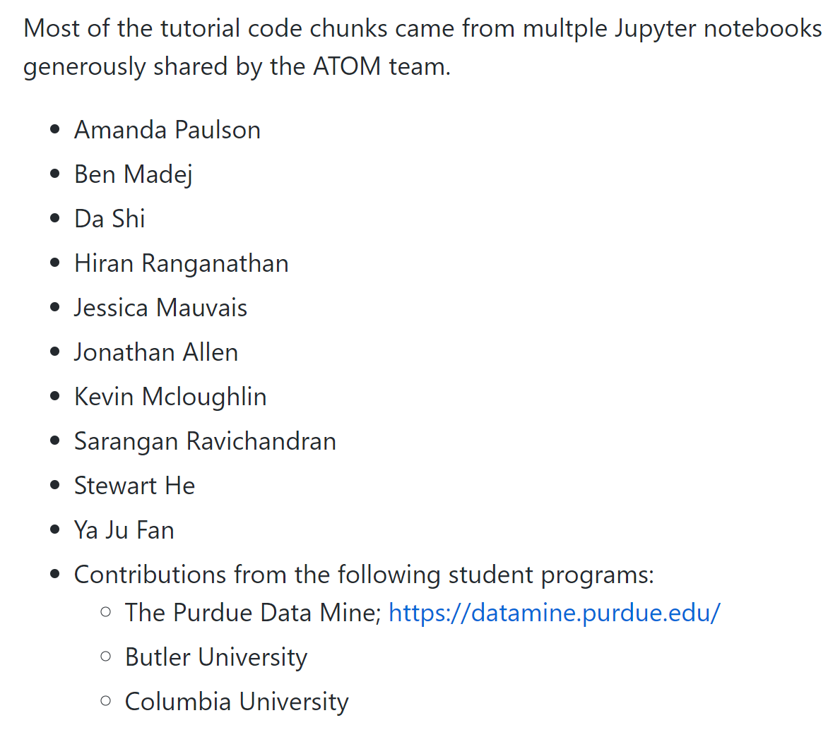
Acknowledgements
ATOM Team

Slide 3
Agenda
Introduction to AMPL (ATOM Modeling Pipeline)
Why AMPL?
Open Source; Active development; Collaborative effort; Supporting pages; You can bring in your own python package and use it along-side AMPL
Goal for today
Data Ingestion + Curation
Featurization
Visualization
ML-ready datasets
ML modeling
Analysis

Slide 4
Steps
Data Ingestion
Data cleaning, tidying
Pre-curation
Feature engineering
Outcome variable IC50 🡪 pIC50
Numerical 🡪 categorical
EDA
FingerPrints 🡪 Tonimoto 🡪 Dimensionality Reduction
Diversity Plots
Aggregate assay (EDA)
Curation
Merge Databases (EDA)
Featurization

Slide 5



Data Sources
ChEMBL: Manually curated repository of small molecules (EMBL/EBI)
~1.9 M compounds; ~11K targets
https://www.ebi.ac.uk/chembl/
ExCAPE-DB (EU program)
~ 1M compounds/1.7K targets
https://solr.ideaconsult.net/search/excape/#
Drug Target commons (Univ of Helsinki)
~1.7M cpds; 13K targets
http://drugtargetcommons.fimm.fi/

Slide 6
Why combine data?
ATOM team’s experience shows that the combined dataset (Union) models show robustness and performance than individual dataset

Slide 7
Overview
ChEMBL
….
….
ExCAPE
DB sources
Cleaning
Cleaning
Data Tidying
…
…
Standardization
Standardization
base_smiles_from_smiles
EDA
…
…
EDA
diversity_plots; heat map, tanimoto similarity
Curation
Curation
Curate_data.aggregate_assay_data
Merge
EDA
diversity_plots; heat map, tanimoto similarity
Featurization
feat.featurize_smiles; feat.compute_mordred_descriptors_from_smiles

Slide 8
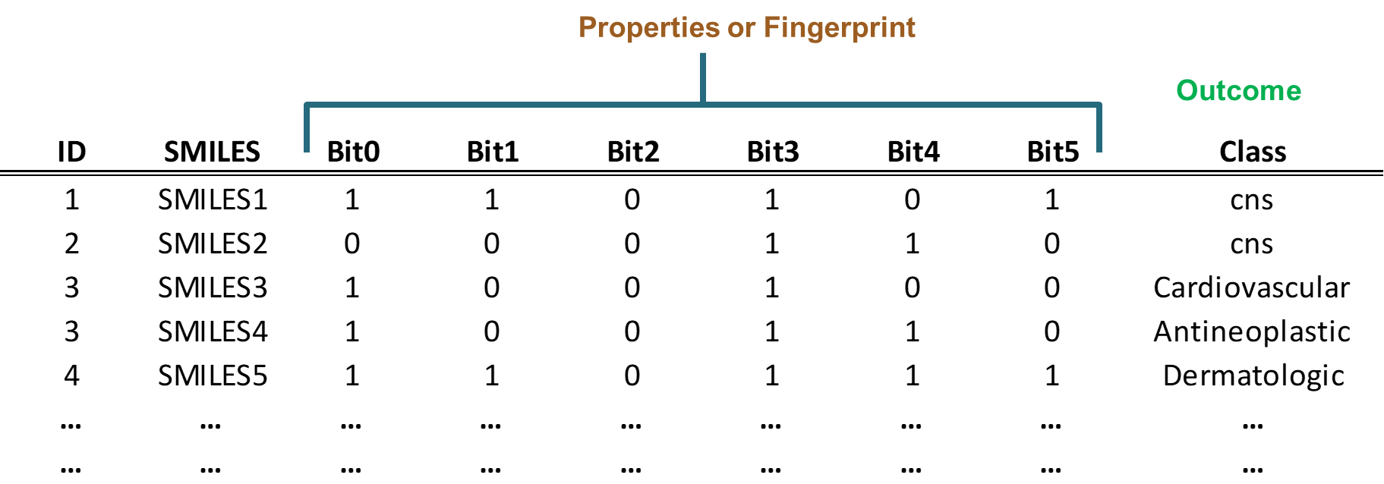
Featurizing a molecule: Fingerprints
Fingerprints
Molecules 🡪 fixed-length binary vectors (0s and 1s). indicating presence/absence of certain molecular features
One can compare fingerprints of two molecules and identify similarity

Slide 9
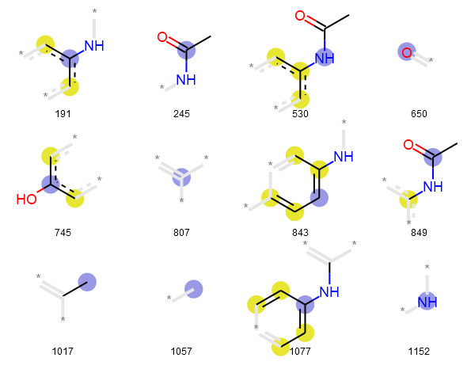
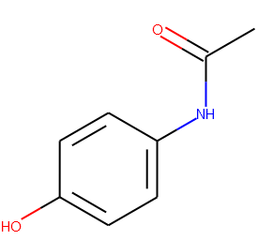
SMILES 🡪 Fingerprint
CC(=O)NC1=CC=C(C=C1)O
000000000000000000000000000000000000000000000000000000000000000000000000000000000000000000000000000000000000000000000000
000000000000000000000000000000000000000000000000000000000000000000000001000000000000000000000000000000000000000000000000
000001000000000000000000000000000000000000000000000000000000000000000000000000000000000000000000000000000000000000000000
000000000000000000000000000000000000000000000000000000000000000000000000000000000000000000000000000000000000000000000000
000000000000000000000000000000000000000000000000001000000000000000000000000000000000000000000000000000000000000000000000
000000000000000000000000000000000000000000000000001000000000000000000000000000000000000000000000000000000000000000000000
000000000000000000000000010000000000000000000000000000000000000000000000000000000000000100000000000000000000000000000000
000100000100000000000000000000000000000000000000000000000000000000000000000000000000000000000000000000000000000000000000
000000000000000000000000000000000000000000000000000000000100000000000000000000000000000000000000010000000000000000000100
000000000000000000000000000000000000000000000000000000000000000000000000100000000000000000000000000000000000000000000000
000000000000000000000000000000000000000000000000000000000000000000000000000000000000000000000000000000000000000001000000
000000000000000000000000000000000000000000000000000000000000100000000000000000000000000000000000000000000000000000000000
000000000000000000000000000000000000000000000000000000000000000000000000000000000000000000000000000000000000000000000000
000000000000000000000000000000000000000000100000000000000000000000000000000000000000000000000000000000000000000000000000
000000000000000000000000000000000000000000000000000000000000000000000010000000000000000000000000001000000000000000000000
000000000000000010000000000000000000000000000000000000000000000000000000010000000000000000000000000000000000000000000100
000000000000000000000000000000000000000000000000000000000000000000000000000000000000000000000000000000000000000000000000
00000000
Paracetamol
https://github.com/ravichas/ML-predict-drugclass (additional information on Fingerprints)

Slide 10
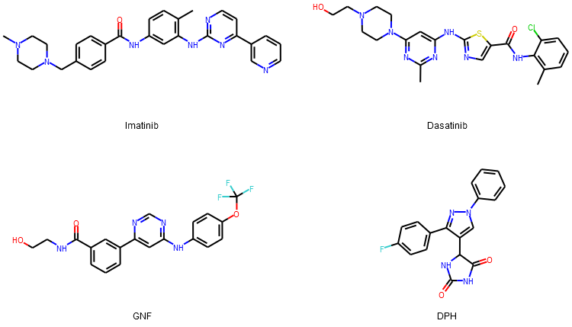
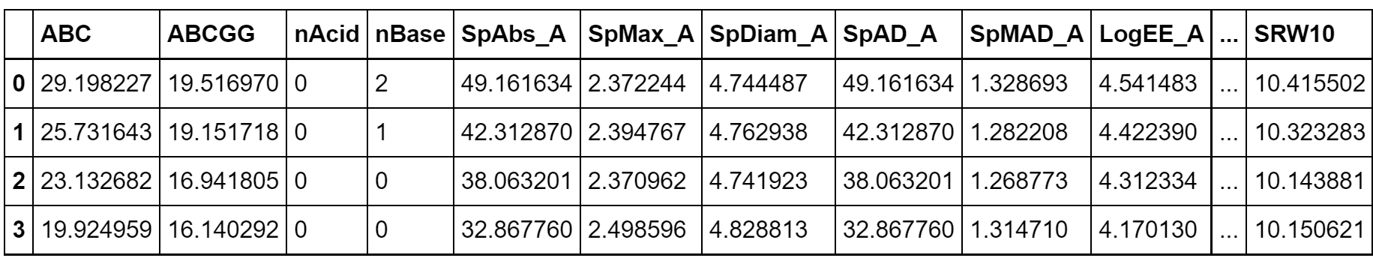
Featurizing a molecule: Molecular descriptors
Physicochemical properties
Molecular weight, # of Hydrogen bond donors, log partition coefficient etc.
Mordred
~1800 descriptors
Open source software
Implemented in AMPL
https://mordred-descriptor.github.io/documentation/master/descriptors.html

Slide 11


Computing Env
This Photo by Unknown Author is licensed under CC BY-SA-NC
COLAB | NIH HPC Biowulf
Serverless | Can ask for resources
Resources are !unlimited and !guaranteed | Resources are guaranteed
Browser-based | Mostly command-line
Good for short jobs; explaining AMPL capabilities | Long jobs (HPO)
Audience: Interns, Workshop attendee (Educational) | Research

Slide 12
Useful links
https://github.com/ATOMconsortium/AMPL
https://github.com/ATOMconsortium/AMPL/tree/Tutorials/atomsci/ddm/examples/tutorials
https://hpc.nih.gov/apps/ampl.html
Workshop materials
https://github.com/ravichas/AMPL-Tutorial (Look for “Workshops” to find the Notebook)
https://github.com/ravichas/AMPL-workshop-1 (optional)

Slide 13
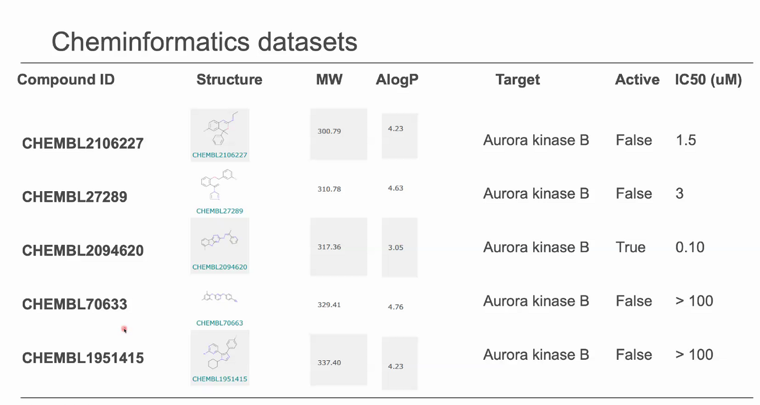
A sample dataset

